Slide 1
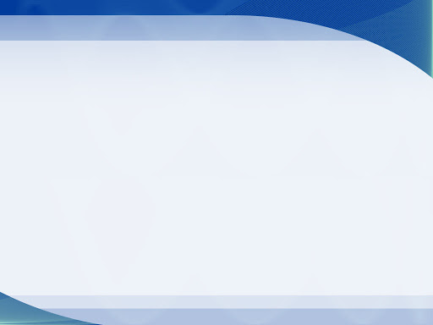
An Integrated Approach for monitoring social distancing and Face mask detection using Stacked Resnet-50 and YOLOv4
PRESENTED BY :
Inder Preet Singh Walia

Slide 2
Dataset Curation and Augmentation
Data Collection:
Images having human faces as single subjects were taken from various sources such as RMFD(Real world masked dataset)
Other images were scrapped from google search.
Face was detected and Facial points were identified using face detection PYPI.
4 types Masks were placed on some faces out of total data curated. (Open CV).
Data Augmentation:
Various blurring techniques were applied on the data from above , to get a more robust dataset since our research includes Low resolution CCTV images.
Average Blur , Motion Blur , Gaussian Blur and other techniques were used to generate more related data.
Data was again augmented using rotation of 15 degrees and horizontal and vertical flip and also zoomed. Only facial data was passed on to the models.
Total images: Masked : 1916 Non Masked : 1930

Slide 3
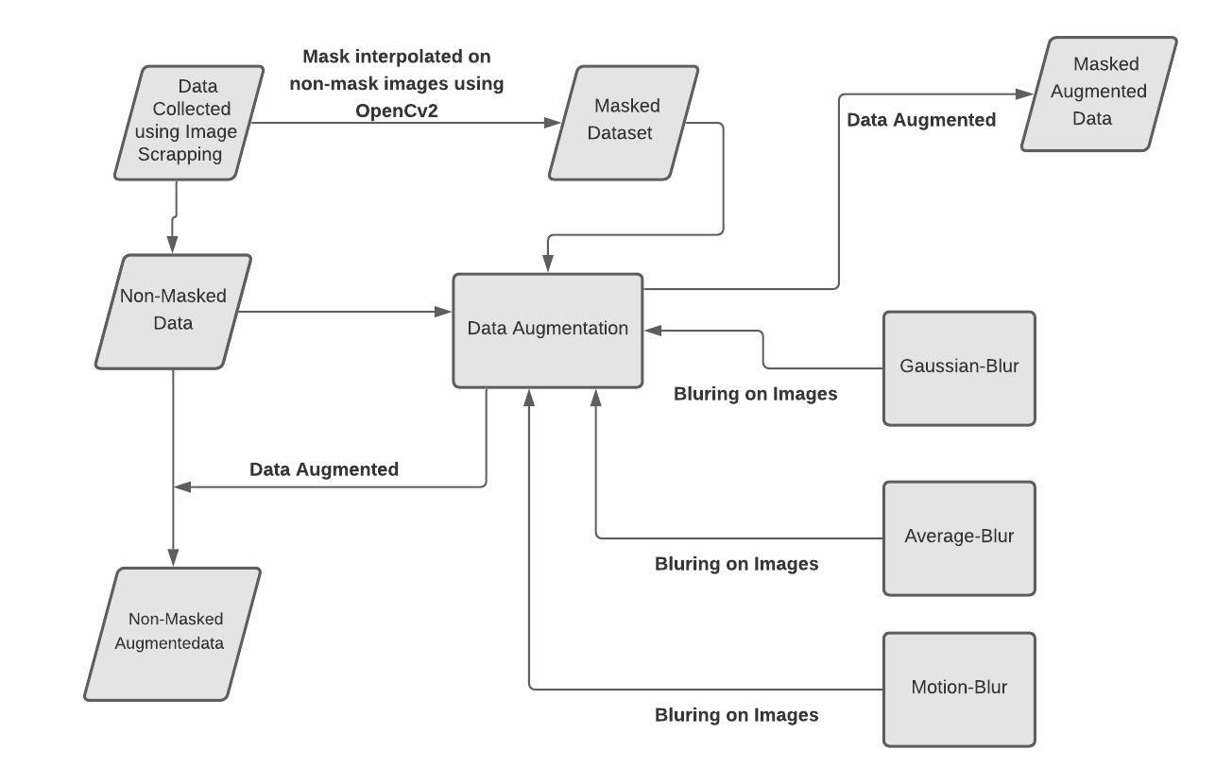
Figure 1. Dataset Preprocessing

Slide 4
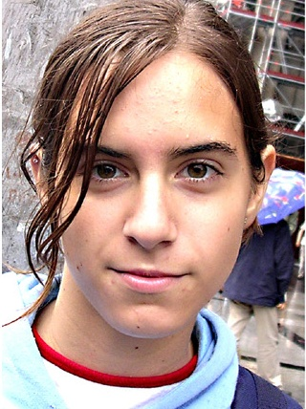
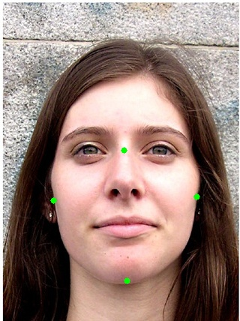
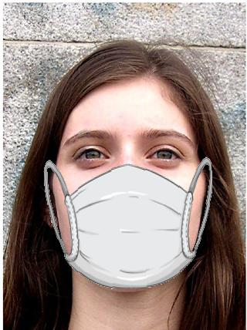
Dataset Curation and Augmentation Cont...
Figure 2:
Non Masked
Figure 3: Facial Points
Figure 4: Masked Images

Slide 5




Dataset Curation and Augmentation Contd.
Figure 5
Original
Figure 6
Gaussian Blur
Figure 7
Average Blur
Figure 8
Motion Blur

Slide 6
RESNET TRANSFER LEARNING
After detecting the faces the model is trained on ResNet-50
Binary Classification of Mask/No mask is done with the help of a pretrained-model of ResNet-50.
Using the technique of transfer learning with the help of ResNet resulted in better Accuracy.
Face Mask Classifier Model was created by adding a few Layers on top of the ResNet50 Pretrained Model.
By applying multiple data augmentation technique like horizontal flip,brightness range,zoom range and image rotation saves the model from overfitting.
The input shape of the model is 224*224*3.
Optimizer used is Adam.
60 Epochs and 32 batch_size.
The learning rate was set to 0.00001.

Slide 7
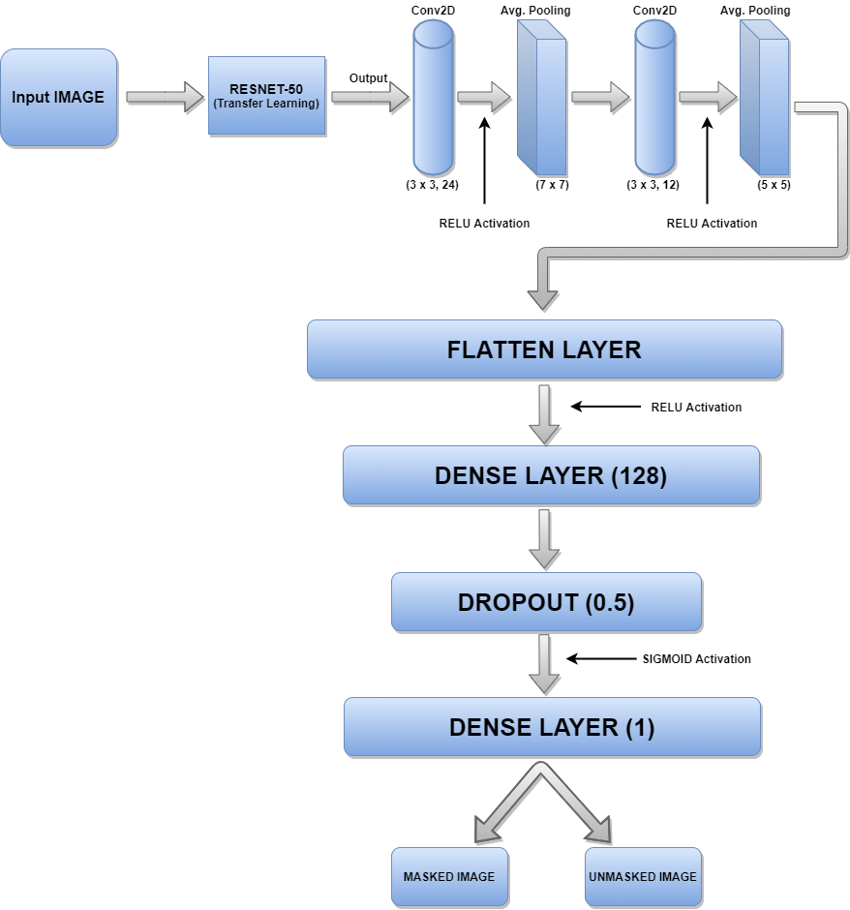
Stacked Resnet Model Architecture
Fig 9. Stacked Resnet Architecture

Slide 8
Table 1. Comparison between CNN, MobileNet, ResNet, Inception v1
 | Model | Accuracy | Precision | Recall | F1-Score | Loss | Specificity
Testing | CNN | 0.75 | 0.51 | 0.65 | 0.52 | 0.18 | 0.48
 | MobileNet | 0.83 | 0.56 | 0.93 | 0.59 | 0.13 | 0.80
 | Stacked ResNet | 0.87 | 0.71 | 0.92 | 0.79 | 0.14 | 0.81
 | INCEPTION v1 | 0.83 | 0.66 | 0.93 | 0.65 | 0.13 | 0.91

Slide 9
RESULT AND ANALYSIS
The models were trained on 1916 masked and 1930 non masked images with data augmentation.
Table 2 shows comparison of various models .
Stacked Resnet -50 with our layers , performed the best out of the 4 models .
Stacked Resnet-50 transfer learning model has 87 percent testing accuracy with 14.5 % loss.
Based on the results , I have decided to use Stacked Resnet for further tasks in the project as it has shown the best results.

Slide 10
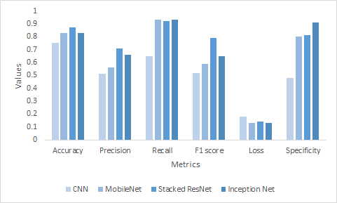
Fig 10 :Performance comparison of different models for testing

Slide 11
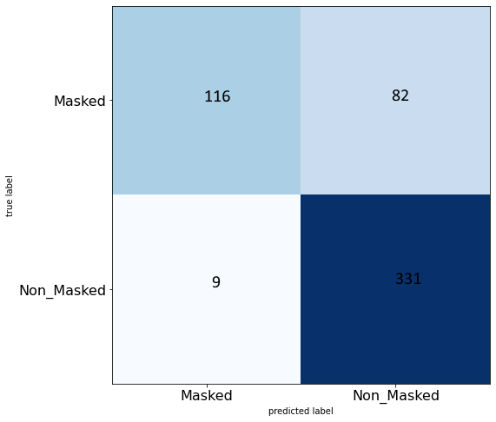
Fig 11 :Confusion Matrix for Stacked Resnet-50

Slide 12
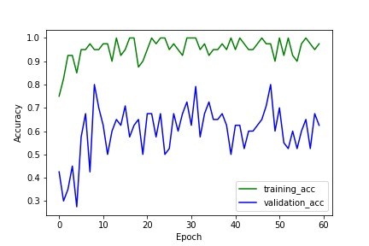
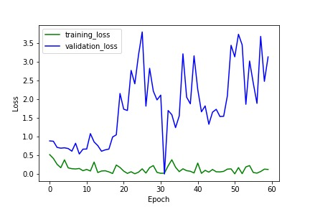
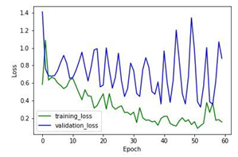
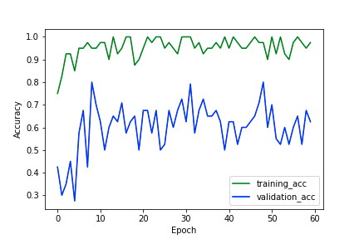
Figure 12
Training and validation accuracy for MobileNet V3
Figure 13
Training and validation Loss for MobileNet V3
Figure 14
Training and validation accuracy for Inception V3
Figure 15
Training and validation Loss for Inception V3

Slide 13
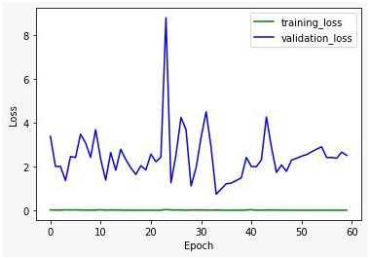
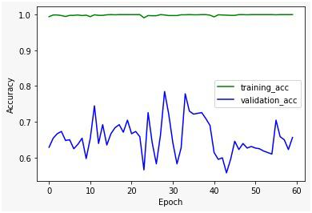
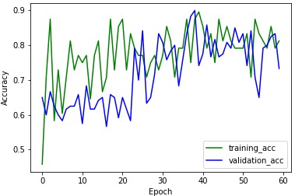
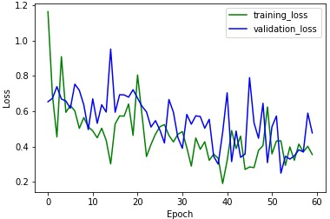
Figure 16
Training and validation accuracy for CNN
Figure 17
Training and validation Loss for CNN
Figure 18
Training and validation accuracy for Stacked Resnet-50
Figure 19
Training and validation Loss for Stacked Resnet-50

Slide 14
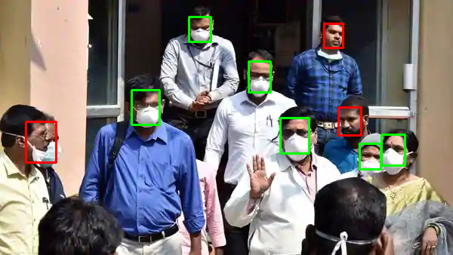
Green: Masked(class1)
Red: Non-Mask(class0)
FIg 20 :Face Mask detection using Stacked Resnet-50

Slide 15
Social Distancing using YOLOv4 and DBSCAN
An input video of length 135 seconds,20fps and 480p have been taken from internet.
Each frame have been extracted and processed to the Yolov4.
Get bounding boxes for Persons in the frame with Yolov4.
Get the position of the person and use DBSCAN to detect clusters by setting up a eps value.
The persons detected have been cropped and these detections have been passed to face detector(DSFD) which extracted the faces of the person.
These low resolution face images have been given as an input to the Stacked Resnet-50 model which classified them into masked or unmasked images.
At the end a bounding box and monitoring status in the frame is resulted..

Slide 16
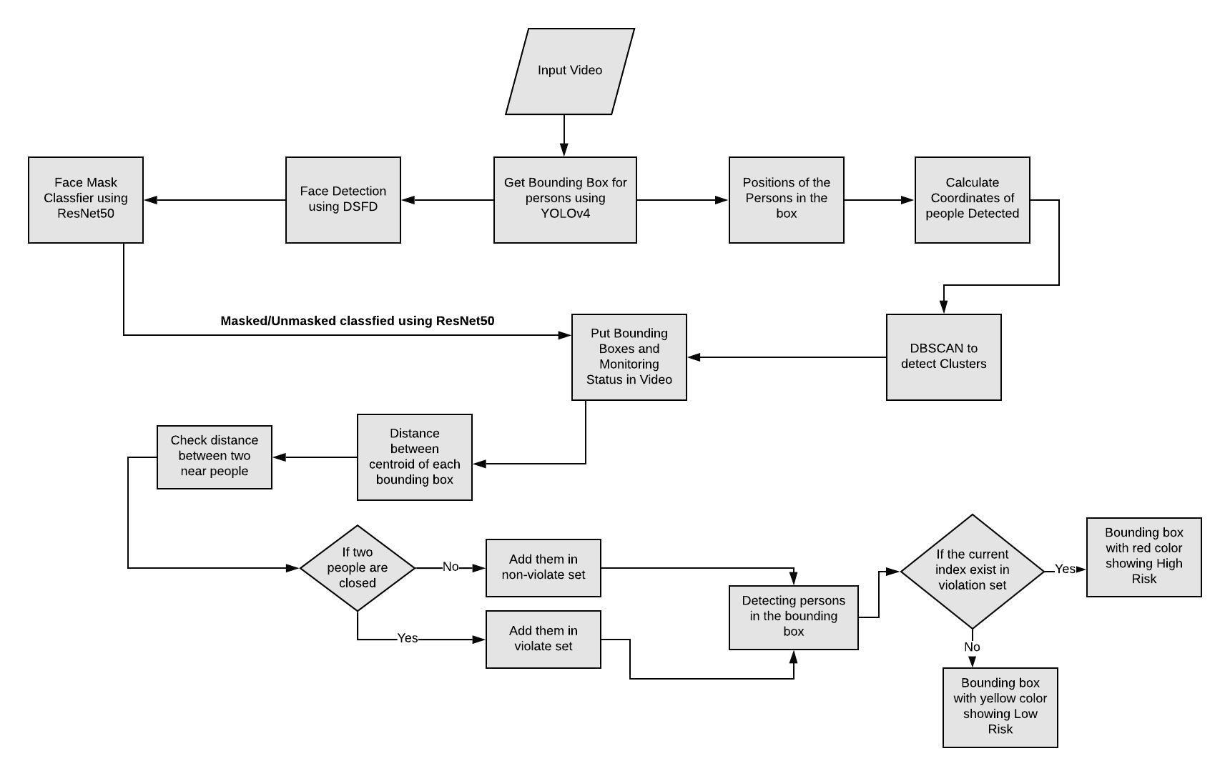
Figure 21
Flowchart of the Methodology

Slide 17
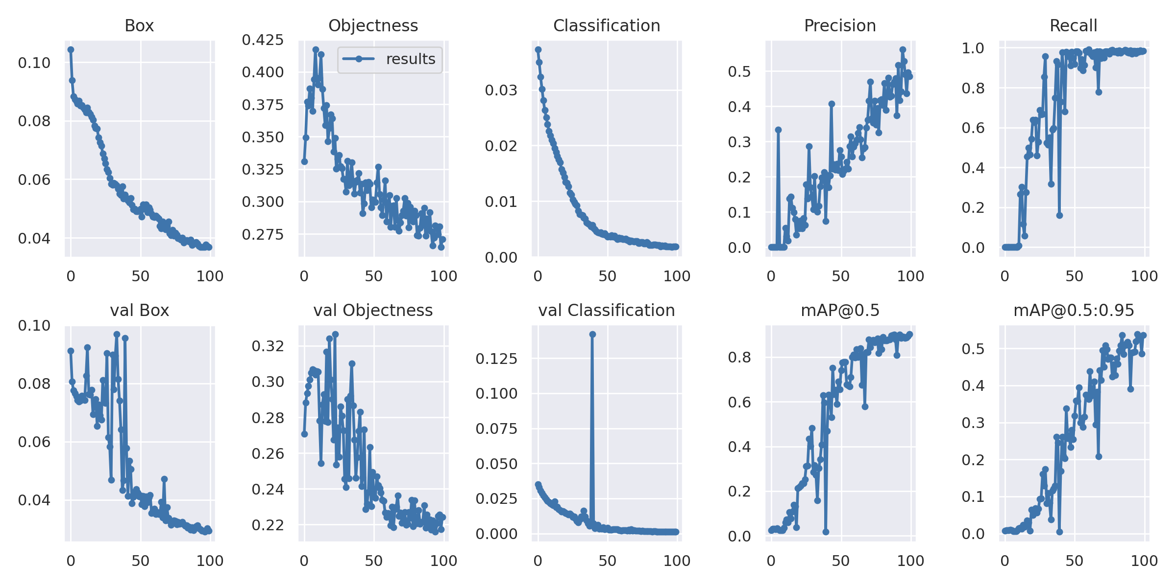
Results of YOLOv4
Figure 22
YoloV4 Results

Slide 18
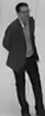
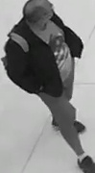
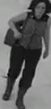
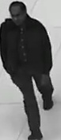
Figure 23
Cropped instances from the video

Slide 19

Video showing real time Social Distancing using YoloV4 and DBSCAN

Slide 20
THANK YOU

